Slide 1

Inventory Location design
hospital supply room
Click to Begin

Slide 2



Navigating through lesson
Navigation Buttons are on the Bottom Right-hand Corner.
The Table of Contents are hyperlinked to the first page of the section.
Click to Move Back to Previous Page
Click to Return to Home Page
Click to Move to Next Page
Click to answer questions or navigate as stated in box

Slide 3
Table of Contents
Introduction
Inventory Management Review
Navigating The Medical Center
Dimensions of Item, Bin, and Location
Removal of an Item
Rationale of Decisions
(Each of these above are hyperlinked to the first page of the section identified)

Slide 4
Section 1 - Introduction
Purpose: Storing medical supplies in a nearby location for health care provider use is essential to treating patients. Each unit has at least one supply room that holds these items maximizing space and ease of access. Setting up inventory locations provides a specific spot for each item.
Goal: Inventory Specialists create medical supply inventory locations to provide storage and efficient access to medical products for the health care workers to meet patient demands.
Audience: Inventory Specialists.

Slide 5
Section 2 - Inventory Management review
Use this section as a review from previous your previous lesson on inventory management. This sets you up for this new lesson.
Inventory in the hospital are supplies to treat patients.
Items can be placed at any location in the supply room.
Health care providers access the supply rooms daily.
True
False
True
False
True
False
Click to continue

Slide 6
Correct!
Great job!
Previous

Slide 7
Not Quite!
Try Again!
Previous

Slide 8
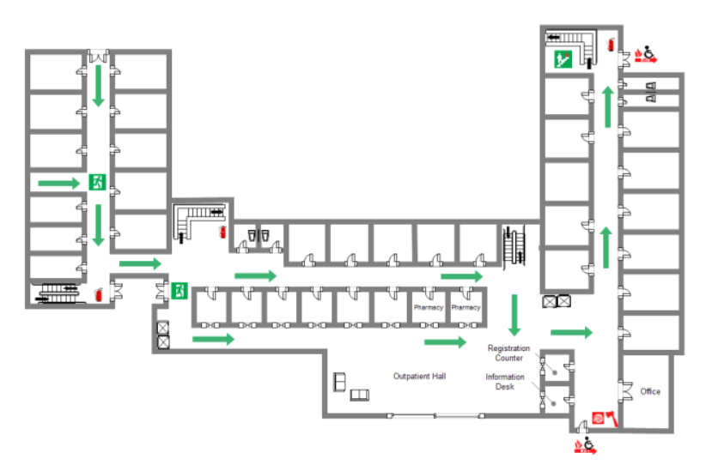
Section 3 - Navigating through the hospital
This map provides context to the medical center you have been navigating this first month of being an Inventory Specialist.
Click the arrow to move to the next slide.

Slide 9
Section 3 - Navigating through the hospital
Objective:
Inventory Specialists will be able to select an efficient path to bring inventory materials to the supply room with minimal patient contact 100% of the time.
Click the arrow to move to the next slide.

Slide 10


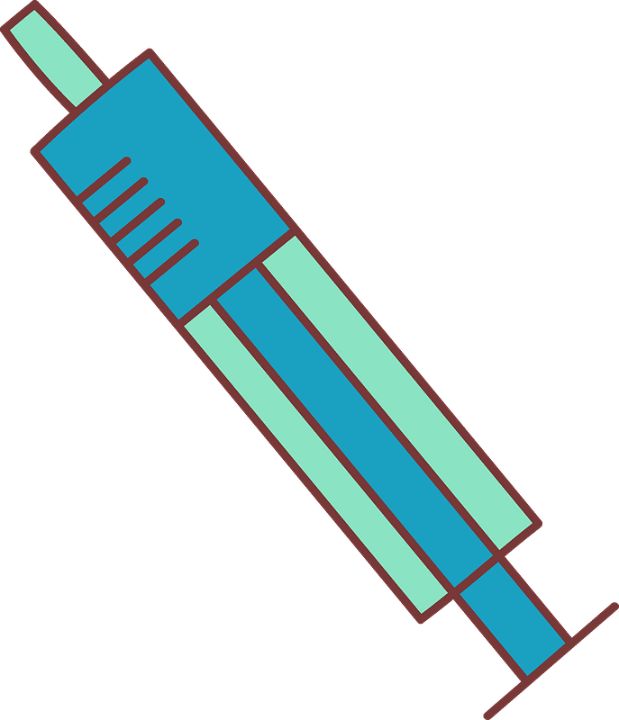
Navigation through the hospital
This bin was prepared in the previous lesson and filled with the new small Flush Syringes needing a new location.
It is best practice to walk to the supply room with minimal patient contact.
The next step is to determine the best route to carry the container to Supply Room 1 on Unit 6.
Flush Syringe
Item: 136222
Supply Room Unit 6 Rm 1
Click to move to the next slide.

Slide 11
Section 3 - Navigating through the hospital
Review this map with the areas within the hospital. Identify high, medium, and low patient traffic areas.
Hallways
Patient Rooms
Nurse Stations
Supply Room
Stairs
Elevators
E
A
B
C
Patient Traffic Areas
High Patient Traffic: A, E
Medium Patient Traffic: B, D
Low Patient Traffic: C
D
Click to move to the next slide.

Slide 12
Section 3 - Navigation through the hospital
Which path to the supply room provides least patient contact?
E
E -> D -> C
A
B -> C
C
B
D
Click to Continue

Slide 13
Section 3 - Navigation through the hospital
This route leaves the supply room in the basement and up the stairs (B) to cross directly to the supply room (C). It is low traffic.
Great job!!!!

Slide 14
Section 3 - Navigation through the hospital
This route passes through two hallways of patient rooms. It is high traffic.
Return to previous screen

Slide 15
Section 3 - Navigation through the hospital
What is the two criteria to bring the inventory bin to the supply room?
Walk past patient rooms
Use stairs nearest supply room
Avoid patient hallways
Go up the patient elevators from the ground floor
Click to Continue

Slide 16
Section 3 - Navigation through the hospital
Great job!!!!
Click to return

Slide 17
Section 3 - Navigation through the hospital
Review the map focusing on where the patient rooms are located in location to supply room.
Try again

Slide 18
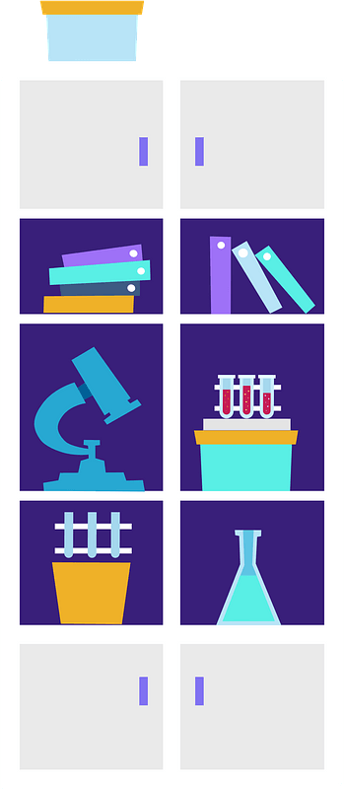
You have arrived at the supply Room!
Create the first part of your electronic job aid.
List the Process 1 criteria and steps that you need to follow when traveling from the Supply Chain Offices to the Supply Room on Unit 6.
Hint: There will be 3 – 5 steps.
Click the arrow to move to the next objective.

Slide 19
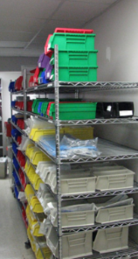
Section 4 - Dimensions of Item, bin, and location
This image is the inside the Supply Room on Unit 6. As you can see there are multiple items on the shelves with each having its own spot.
Click the arrow to move to the next page.

Slide 20
Section 4 - Dimensions of item, bin, and location
Objective:
Inventory Specialists will be able to identify the required dimensions of an inventory location needed to store the new products in the supply room with 100% accuracy.
Flush Syringe
Item: 136222
Supply Room Unit 6 Rm 1
Click the arrow to move to the next page.

Slide 21

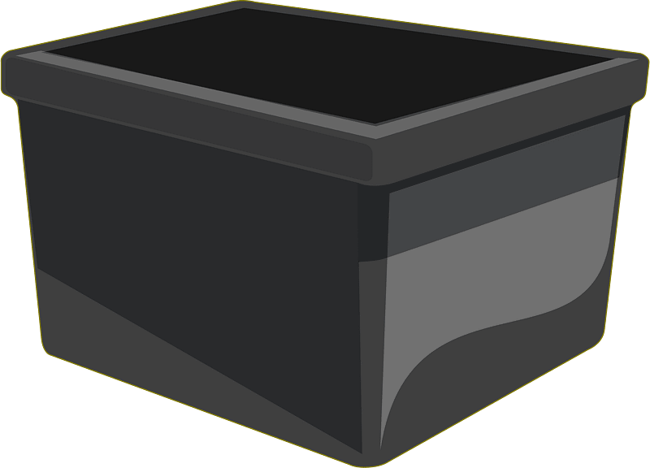

Section 4 - Dimensions of Item, bin, and location
Bins are used for storage in the Supply Rooms. Each color holds a different category of supplies.
Bin Color | Category
Green | Patient Care
Black | Electric Leads
Red | Circulatory
Yellow | Urinary
Blue | Airway
Click the arrow to move to the next page.

Slide 22
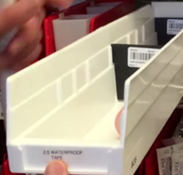
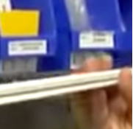
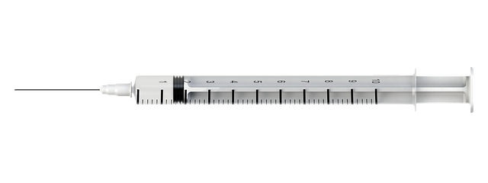
Section 4 - Dimensions of item, bin, and location
When determining the location for the flush syringe, you need to consider the size of the item, the size of the bin, and the size of the location. The bin needs to hold the number of syringes needed determined by anticipated use.
Click the arrow to move to the next page.
Flush Syringe Dimensions = 2 x 2 x 6”
Bin Dimensions = 7 x 4 x 12”
Location Dimensions = 8 x 4 x 12”

Slide 23

Section 4 - Dimensions of item, bin, and location
PAR Level is what the number of flush syringes needed. The PAR is 25.
First step is to calculate the volume of the item, bin and location.
Volume of the syringe = 1in*2in*6in = 24in³
Volume of the bin = 7in*4in*12in = 336in³
Volume of location = 8in*4in*12in = 384in³
Click the arrow to move to the next page.
Flush Syringe Dimensions = 2 x 2 x 6”
Bin Dimensions = 7 x 4 x 12”
Location Dimensions = 8 x 4 x 12”

Slide 24
Section 4 - Dimensions of item, bin, and location
Second step is to determine if all items will fit in the bin.
Volume of total syringes = 12in³*25 = 300in³
The syringes will fit into the bin.
Item | Volume
Flush Syringe | 300in
Bin | 336in
Location | 384in
The syringes will fit into the bin.
Click the arrow to move to the next page.

Slide 25
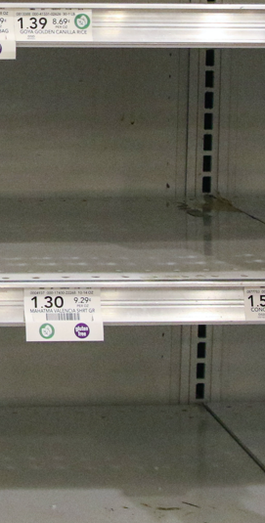
Section 4 - Dimensions of item, bin, and location
Calculate the volume of this location and click on the correct answer.
14”
10”
1255in³
896in³
8”
1120in³
1322in³
Click to Continue

Slide 26
Section 4 - Dimensions of item, bin, and location
Great Job!
Return to Previous Page

Slide 27
Section 4 - Dimensions of item, bin, and location
Not Quite.
Review how to complete calculations.
Return to Previous

Slide 28
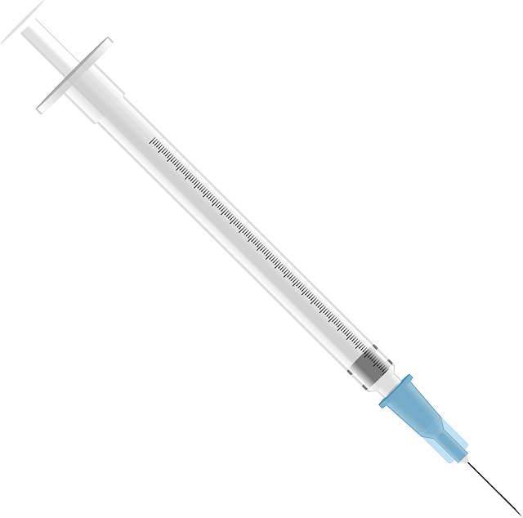
Section 4 - Dimensions of item, bin, and location
The measurement of these syringes are 2” x 1” x 4”.
Calculate the volume of a PAR of 30.
Select the correct answer.
210in³
240in³
220in³
Click to Continue

Slide 29
Section 4 - Dimensions of item, bin, and location
Not Quite. Check formula.
Try Again.
Return

Slide 30
Section 4 - Dimensions of item, bin, and location
Great Job!!!
Continue

Slide 31
Section 4 - Dimensions of item, bin, and location
Which bin fits in a 300in³ location?
2”x4”x30”
5”x8”x12”
Click to Proceed

Slide 32
Section 4 - Dimensions of item, bin, and location
Great Job!!!
Click to Previous

Slide 33
Section 4 - Dimensions of item, bin, and location
Not Quite.
Try Again.
Return

Slide 34
Section 4 - Dimensions of item, bin, and location
Which bin fits best in a location?
Bin Location
Bin A = 355in³ Location 1 = 12”x2”x4”
Bin B = 122in³ Location 2 = 12”x6”x7”
Bin C = 85in³ Location 3 = 10”x6”x12”
Click to check your answers

Slide 35
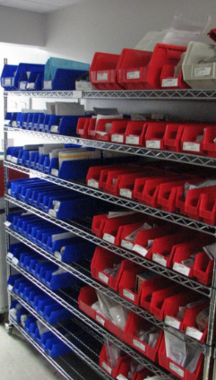
Section 4 - Dimensions of item, bin, and location
Bin A = Location 3
Bin B = Location 2
Bin C = Location 1

Slide 36
Section 4 - Dimensions of item, bin, and location
Create the second part of your electronic job aid.
List the Process 2 criteria and steps that you need to fit a bin full of a supply in a location.
Hint: There will be 5 – 7 steps.
Click the arrow to begin the next objective.

Slide 37
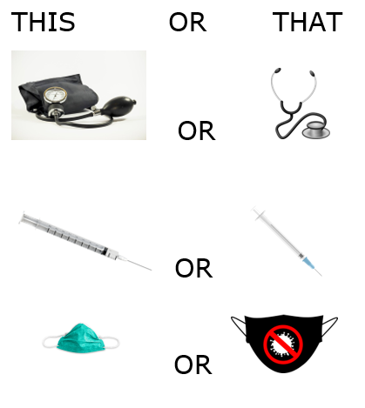
Section 5 - Removal of an item
This or That – Fun Thoughts!
Sometimes it is difficult to remove something from a closet.
Look at the two images together. Think about which on of the pair you like better.
When done, click the arrow to move to the next page.

Slide 38
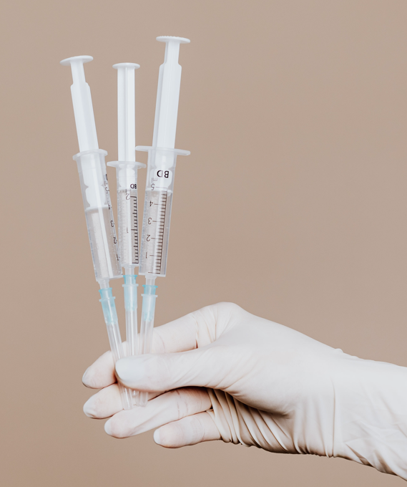
Section 5 - Removal of an item
Objective:
Inventory Specialists will be able to select one low-use item to remove from the supply room and replace it with the new item 100% of the time.
Click the arrow to move to the next page.

Slide 39
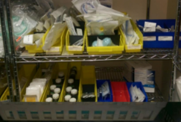
Section 5 - Removal of an item
YIKES!!!!!
Based on the last section on learning how to determine item volume, bin volume, and location volume, you should notice this supply room shelf has opportunities for improvement!
At some points, it is necessary to remove an item to provide an organized space.
Click the arrow to move to the next page.

Slide 40

Section 5 - Removal of an item
The WMS is the warehouse management system providing the virtual location of items. It keeps track of how often inventory is replenished.
To find space for the new syringes, one item needs removed. To select the item to remove, determine which item has the lowest use and a similar weight.
Click the arrow to move to the next page.

Slide 41
Section 5 - Removal of an item
Review information in the WMS for 5”x 8” band aids.
Location number: E53 on the top shelf.
Item Number: 174982
Weekly Use: 10
One month use: 45
One bin holds 600 of this item. This is a low use item. With a similar weight as the syringes, this switch meets ergonomic consideration.
Click the arrow to move to the next page.

Slide 42
Section 5 - Removal of an item
Review the two items. Identify which one is high use and which one is low use.
Item 1: 45 gauze pads in one bin. 30 used per month.
Item 2: 5 chest tubes in one bin. 15 used per month.
Click the arrow to move to the next page to check your answer.

Slide 43
Section 5 - Removal of an item
Although there are more gauze pads used in one month, the percentage use is less than that of the percentage use of the chest tubes.
Item 1: 45 gauze pads in one bin. 30 used per month = 67%
Item 2: 5 chest tubes in one bin. 15 used per month = 300%.
To test yourself, click the arrow to move to the next page.

Slide 44
Section 5 - Removal of an item
Test your knowledge!
Item 1: 15 gauze pads in one bin. 45 used per month.
Item 2: 8 rolls of IV tape in on bin. 15 used per month.
Which one has higher percentage of use?
Item 1
Item 2
Click to Proceed

Slide 45
Section 5 - Removal of an item
Good Job with Calculations!
Click to Return

Slide 46
Section 5 - Removal of an ITem
Review your calculations and compare percentages.
Try Again

Slide 47
Section 5 - Removal of an item
Test Your Knowledge! Determine which one has lower use.
When you have your answers, check your answers by clicking the arrow button to the next page.
This | Or | That
Item 1 = 50 in Bin, 75 used monthly | OR | Item 2 = 20 in Bin, 15 use monthly
Item 3 = 55 in Bin, 30 used monthly | OR | Item 4 = 65 in Bin, 125 used monthly
Item 5 = 22 in Bin, 44 used monthly | OR | Item 6 = 25 in Bin, 60 used monthly

Slide 48
Section 5 - Removal of an item
The correct answers are highlighted in yellow.
How did you do?
Review the section if you need more practice.
This | Or | That
Item 1 = 150% | OR | Item 2 = 75%
Item 3 = 55% | OR | Item 4 = 192%
Item 5 = 200% | OR | Item 6 = 240%

Slide 49
Section 5 - Removal of an Item
Create the third part of your electronic job aid.
List the Process 3 criteria and steps that you need to fit a bin full of a supply in a location.
Hint: There will be 4 – 6 steps.
Click the arrow to move to the next objective.

Slide 50


Section 6 - Rationale of decisions
Be Careful Where You Store Heavy Objects!!
OUCH!!!!

Slide 51
Section 6 - Rationale of decisions
Objective:
Inventory Specialists will be able to provide a rationale for the final selection of the inventory location for ergonomic conditions and quick access to supplies for healthcare providers 100% of the time.

Slide 52
Section 6 - Rationale of decisions
Bins create an organized supply room.
Determining where a bin of product is located on the shelf is based on the weight of the product and the frequency of use by the health care providers.
Heavy items should not be on the top shelves. It causes health care providers to extend reach to lift the item off the shelf increasing risk of injury. Keep those shelves for light weight and low use items like hazardous bags used to carry items to the lab.

Slide 53
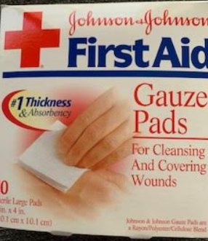
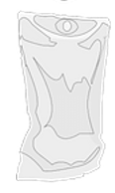
Section 6 - Rationale of decisions
IV Bags are heavier items used frequently. The most used solution is Normal Saline Solution. These bags should be placed lower on the shelves than items such as gauze.
Gauze is a frequently used item that has a low weight. This item can be placed on the upper shelves.
Since both the IV Bags and Gauze are high use items, they need to be placed near the door so health care providers can obtain them quickly without overreaching.
This setup supports ergonomics as it minimizes extended reaching and prevents reaching heavy items at the top of shelves which can strain muscles.

Slide 54
Section 6 - Rationale of decisions
This activity is called High or Low. Review the item and its weight. Determine if it is top half or bottom half of the shelving unit.
Bandaids – 2oz
One-gallon sterile water
IV Tape – 1 oz
Syringe
High
Low
High
Low
High
Low
High
Low
Click here to Continue

Slide 55
Section 6 - Rationale of decisions
You have this down!!!
Great job!!!
Return to Previous Page

Slide 56
Section 6 - Rationale of decisions
Take another look at the item.
Return to Previous Page

Slide 57
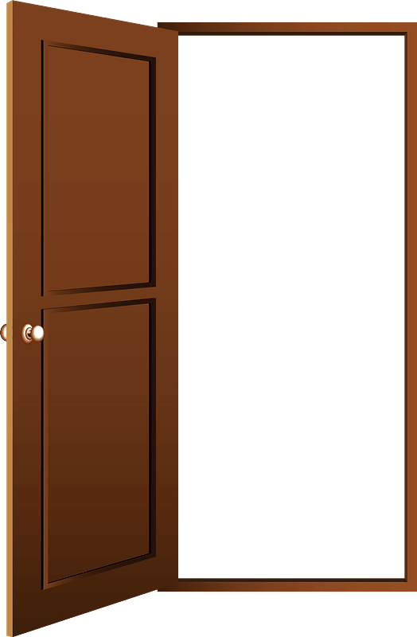

Section 6 - Rationale of decisions
This activity is called Near or Far.
On average, a health care provider gets the same item out of the supply room five times per day. Anything over five times needs to be near the door to the supply room. This allows the health care provider to minimize movement and reducing time it takes to obtain the supply.
Click the arrow to move to the next slide.

Slide 58
Section 6 - Rationale of decisions
This activity is called Near or Far.
Review the item and its use. Determine if needs to be near the door or if it is OK to be further into the supply room.
Medical Tape – 20 times/day
Lotions – 1 time/day
Butterfly needle – 10 times/day
IV Tubing – 12 times/day
Near
Further In
Near
Further In
Near
Further In
Near
Further In
Click here to Continue

Slide 59
Section 6 - Rationale of decisions
You have this down!!!
Great Job!!!
Return to Previous Page

Slide 60
Section 6 - Rationale of decisions
Take another look at the item.
Return to Previous Page

Slide 61
Section 6 - Rationale of decisions
Great job completing this part of the lesson!
Create the fourth part of your electronic job aid.
Provide how materials should be organized in a supply room.
Hint: There will be 3 – 5 steps
Click the arrow to move to the next page.

Slide 62
Congratulations!!!!
Excellent Job Completing This Lesson!
At this point you should have an Electronic Job Aid that will help you as you set up inventory locations in the future.
Please upload it to the SharePoint Site for manager to review.
Images provided by Nancy Garso or Open Access

